Slide 1
NODE.JS
(The Backend Of MERN Stack)
Lecture 30

Slide 2
Today’s Agenda
Creating Database Using “use” Command
Listing All Databases
Creating And Deleting Collection
CRUD Operations
Different Ways Of Inserting Document
Displaying Document

Slide 3
Creating database in mongodb
In MongoDB, the first basic step is to have a database and collection in place.
The database is used to store all of the collections, and the collection in turn is used to store all of the documents.
The documents in turn will contain the relevant Field Name and Field values.

Slide 4
Using the “use” command
To create/connect to a database we use the “use” command in the mongo shell.
Syntax:
use <database_name>
Example:
use humanResourcedb
Explanation:
The above code will either create a database called humanResourcedb if it does not exists , otherwise it will simply connect to it.

Slide 5
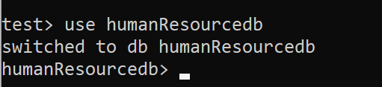
Using the “use” command

Slide 6
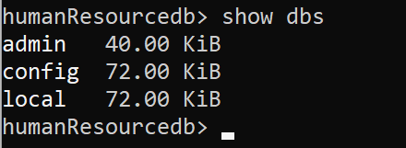
Listing the database
To check all the databases, use the "show dbs" command, as shown below.
Why our database didn’t show up ?
Our created database (humanResourcedb) is not present in the list because we need to insert at least one document into it.

Slide 7

deleting a database
To delete a database, we use the db.dropDatabase() method which deletes the current database.
Above, { ok: 1, dropped: 'humanResourcedb' } indicates that the database deleted successfully.

Slide 8
Creating collection in mongodb
A collection in MongoDB is similar to a table in RDBMS.
To create a collection, we use the db.createCollection() method passing it the name of collection as a string.

Slide 9

Creating collection in mongodb
The following code creates a new employees collection in the current database, which is humanResourcedb:
It returns an object { ok: 1 }, which indicates that the collection was created successfully.

Slide 10
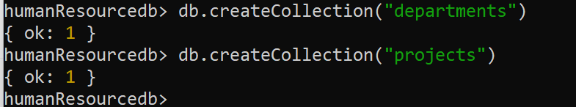
Creating multiple collections
We also can create more than one collection in a single database as shown below:

Slide 11
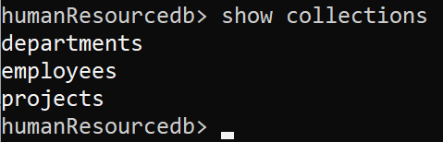
Listing all collections
We use the show collections command to list all the collections in a database.

Slide 12

deleting a collection
To delete a collection we use the method db.<collection_name>.drop()
It returns a boolean value of true or false to indicate whether collection was dropped or not.

Slide 13

verifying
We can verify whether the “projects” collection was dropped or not by listing all the collections:

Slide 14
Crud operations in mongodb
CRUD operations refer to the basic Insert, Read, Update and Delete operations.
We already know how to create a database and collection.
Now let’s discuss how to perform CRUD operations in MongoDB.

Slide 15
Inserting documents
MongoDB provides the following methods to insert documents into a collection:
insertOne() - Inserts a single document into a collection.
insertMany() - Insert multiple documents into a collection.

Slide 16
Using insertOne()
We use the db.<collection>.insertOne() method to insert a single document in a collection.
db points to the current database, <collection> is existing or a new collection name.
Syntax:
db.<collection_name>.insertOne(<document>);
What is document here ?:
It’s the JS object we want to be inserted into the collection.

Slide 17
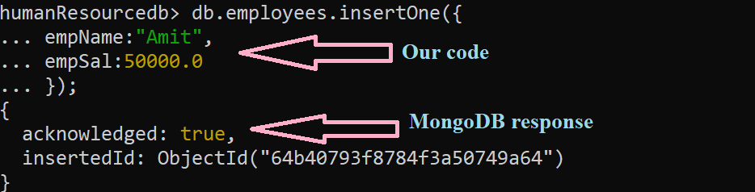
Example of insertOne()

Slide 18
explanation
Explanation Of MongoDB Response For insertOne():
MongoDB returns an object with 2 fields called acknowledged and insertId.
The boolean field acknowledged indicates whether the insert operation is successful or not.
MongoDB needs a unoique id for every document but since we haven’t specified the _id field so, MongoDB inserts a document to a collection with the auto-generated unique _id field and returns insertedId field with the newly inserted value of _id .

Slide 19
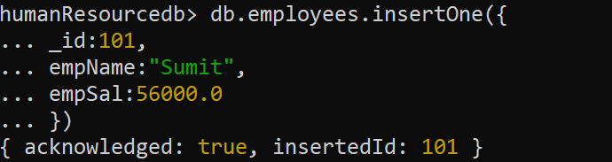
Insert_id manually
It is not necessary to insert the auto-generated value for the field _id.
We can manually specify a unique value for the _id field, as shown below.

Slide 20
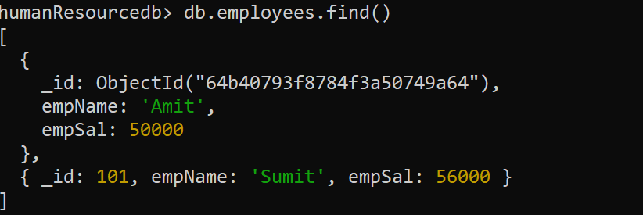
How to view the documents ?
To view all the documents in a collection we use the method db.<collection_name>.find()

Slide 21
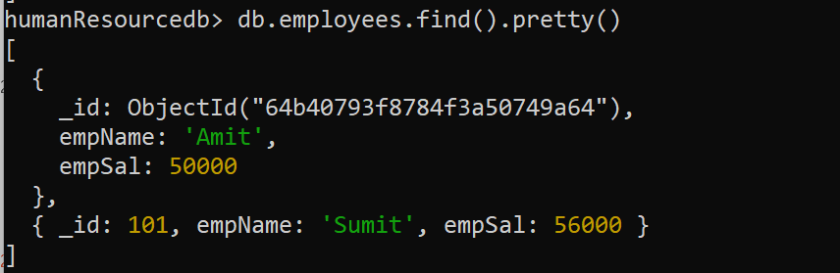
Formatting the output
Many times the output of find() is not in any format and less-readable.
To improve the readability, we can format the output in JSON format by appending the method pretty() with find().

Slide 22
Using insertMany()
We use the db.<collection>.insert() method to insert a an array of documents into a collection.
Syntax:
db.collection.insertMany(
[document1,document2],
{
writeConcern: <document>,
ordered: <boolean>
})

Slide 23
Parameters of insertMany()
array of documents: An array of documents to insert into the collection.
writeConcern: It is an optional argument to control the write behaviour. Generally we use its default settings.
ordered: It is also an optional argument and holds a boolean value indicating whether it's ordered or unordered insert operation.

Slide 24
What is ordered/unordered ?
Ordered decides what will MongoDB do if during insertion of a particular record any error occurs.
If we set it to true then if an error occurs with one of the documents, then MongoDB will return without processing the remaining documents in the array.
If we set it to false, then MongoDB will process all the documents even if an error occurred.
Its default value is true.

Slide 25
Return value of insertMany()
returns a document that includes the newly inserted documents' _id field values.
The method insertMany() returns a document that includes the newly inserted documents' _id field values.

Slide 26
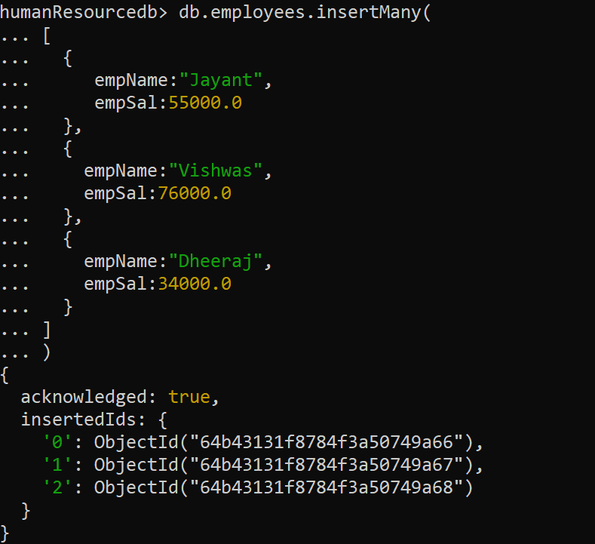
Example of insertMany()

Slide 27
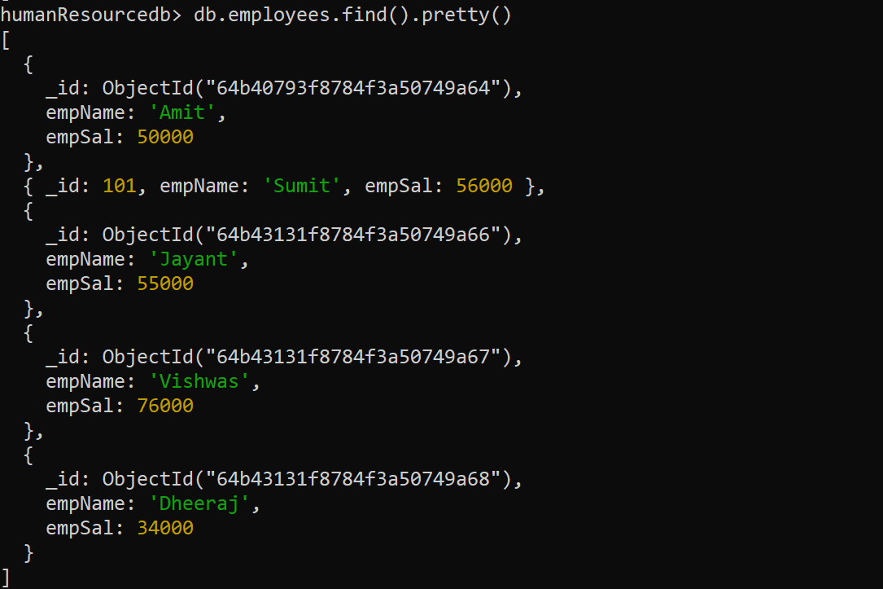
Showing all documents

Slide 28
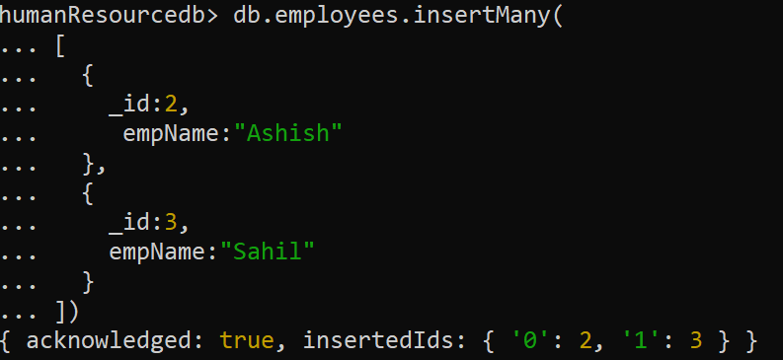
Passing _id in insertMany()

Slide 29
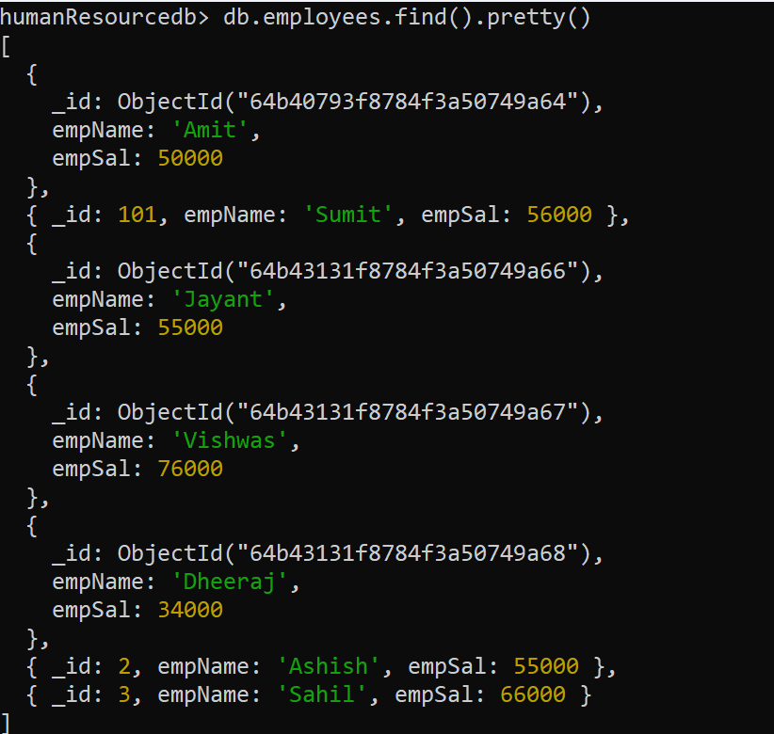
Showing all documents

Slide 30
Special point
By default, the insertMany() method performs ordered inserts.
So, if an error occurred in any of the documents, then it won't process the remaining documents.
For example, the code on next slide tries to insert a second document with an existing _id value.

Slide 31
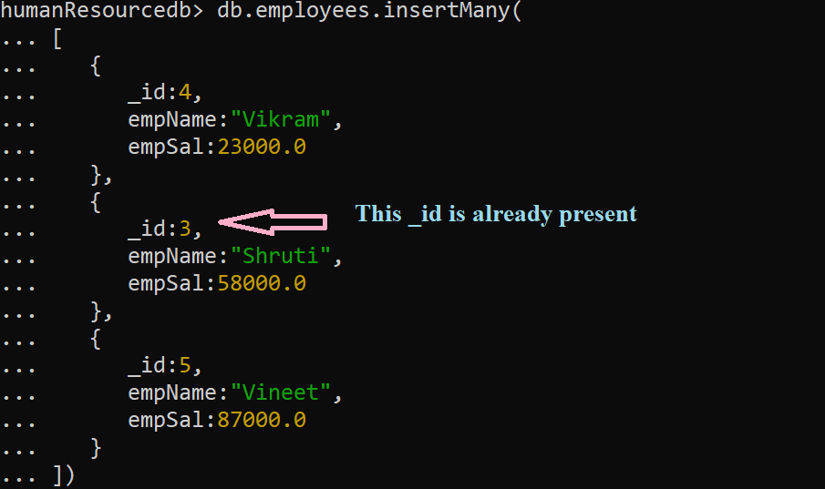
Passing DUPLICATE _id

Slide 32
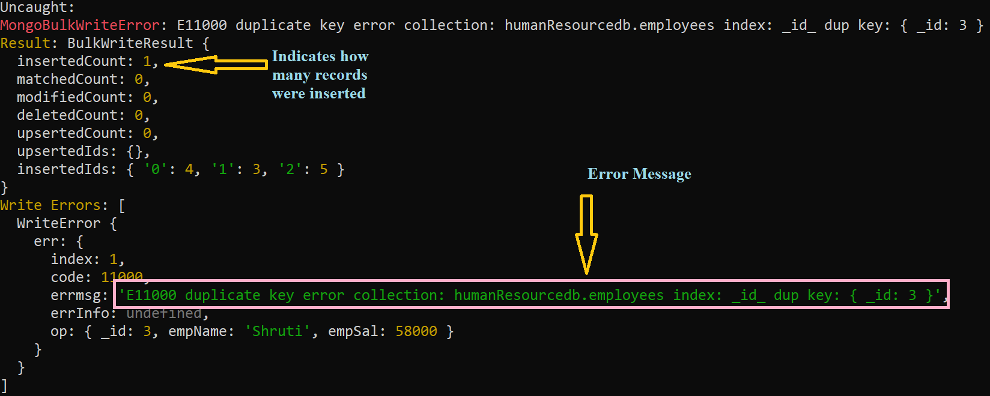
Mongo’s response

Slide 33
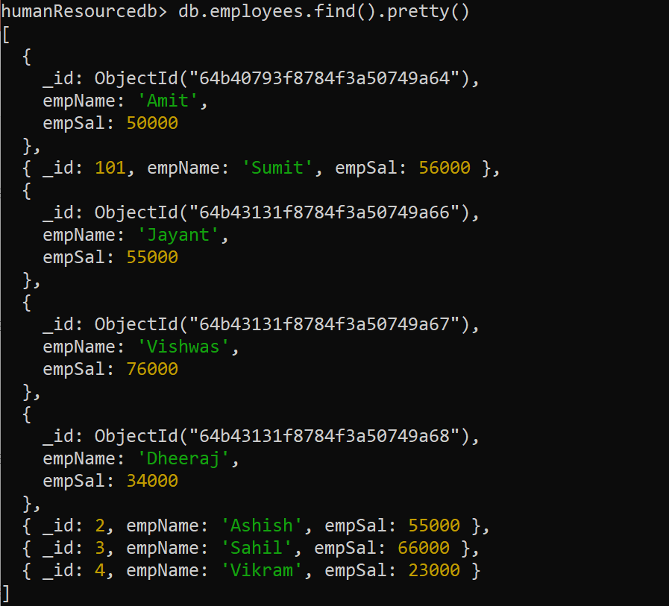
Showing all documents

Slide 34
explanation
In the previous output, an error was encountered by MongoDB while inserting the second document.
So, it only inserts the first document.
The key insertedCount indicates the number of documents inserted successfully.

Slide 35
Setting ordered to false
If we specify the {ordered:false} to perform unordered insert then MongoDB will insert all the valid documents even if an error occurs.

Slide 36
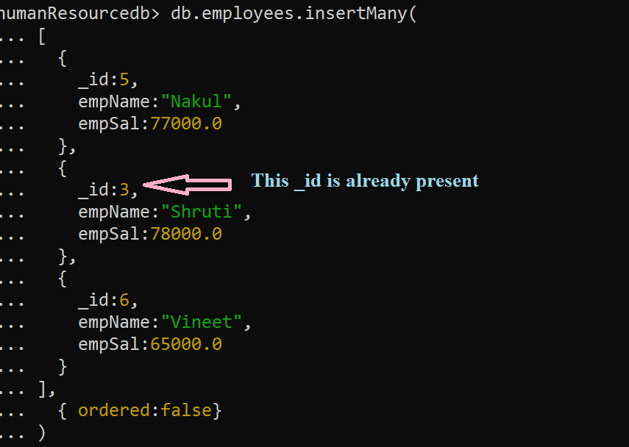
Passing DUPLICATE _id

Slide 37
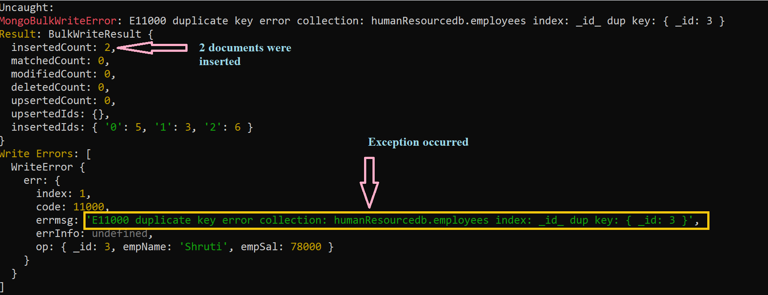
Mongo’s response

Slide 38
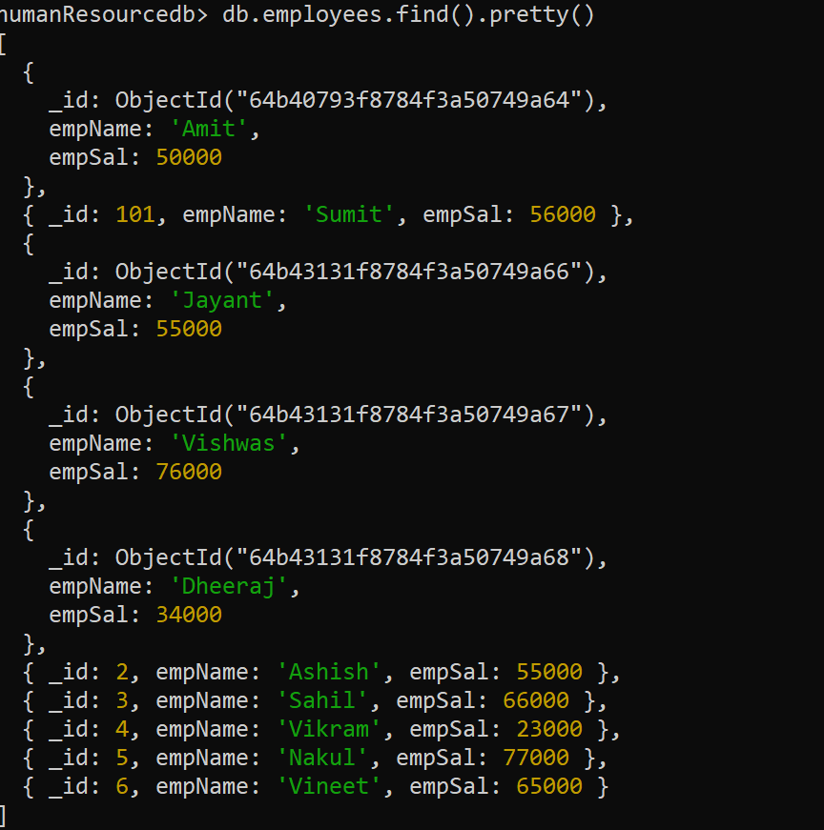
Showing all documents

Slide 39
Data types in mongo
Given on the next slide are some prominent MongoDB data types.
Most of the data types are same as JS data types with some new types.

Slide 40
Data types in mongo
Data type | Purpose
Double | To store floating point value
String | To store utf-8 strings
Object | To store embedded documents
Array | To store arrays or list or multiple values into one key
Binary data | To store binary data.
Object Id | To store document’s ID
Boolean | To store true/false
Date | To store date in Unix format
Null | To store null value
Integer | To store int values
Code | To store JS code
Min key/Max key | For comparison

